Slide 1
RSM222
Management Accounting 1
Class 9: In Class Exercise – Variance Analysis
Elisa Zuliani

Slide 2
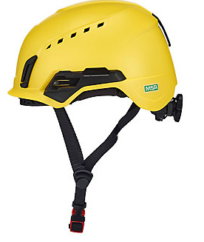
IN CLASS EXAMPLE
Emerson Sports

Slide 3
Actual Results
Did the company perform well?

Slide 4
Flex Budget: Actual Quantity * Standard Price
1. Prepare a Flexible Budget
Flex Budget | Quantity | Price/Cost per unit | Total | Actual | Variance | Favourable/ Unfav.
Sales | 4,800 | $229 | $1,099,200 | $1,080,000 | $19,200 | U
Direct Materials 3pnd @ 15.00 | 4,800 | $45 | $216,000 | $197,280 | 18,720 | F
Direct Labour 3 hours @ $21 | 4,800 | $63 | $302,400 | $300,960 | $1,440 | F
Variable MOH $3.5 per DLH | 4,800 | $10.50 | $50,400 | $45,350 | $5,050 | F
Fixed MOH $9.5 per DLH |  | $28.50 | $136,800 | $140,960 | $4,160 | U
Margin |  | $82 | $393,600 | $395,450 | $1,850 | F

Slide 5
2. Compute the Sales Price Variance and Sales Quantity Variance
Sales Price Variance
= (AQ x AP) – (AQ x SP)
= (4,800 * $225) – (4,800 * $229)
= $1,080,000 - $1,099,200
= $19,200 U
Where did we see this?
Sales Volume Variance
= (AQ x SP) – (SQ x SP)
= (4,800 * $229) – (4,500 * $229)
= $1,099,200 - $1,030,500
= $68,700 F
Sum = $49,500 F
Look at Actual vs. Budget…

Slide 6
3. Compute the Materials Variance
Material Price Variance
= (AQ × AP) – (AQ × SP) or AQ (AP – SP)
= (3*4,800 * $13.70) – (3*4,800 * $15)
= $197,280 - $216,000
= $18,720 F
Material Quantity Variance
= (AQ x SP) – (SQ x SP) or SP (AQ – SQ)
= (3 pounds* $15) - (3 pounds* $15)
= $45 - $45
Sum = $18,720 F
Look at Flex Budget…
= $0
21

Slide 7
4. Compute the Labour Variance
Labour Rate Variance
= (AQ x AP) – (AQ x SP) or AQ (AP – SP)
= (3.3*4,800 * $19) – (3.3*4,800 * $21)
= $300,960 - $332,640
= $31,680 F
Labour Efficiency Variance
= (AQ x SP) – (SQ x SP) or SP (AQ – SQ)
= (3.3*4,800 * $21) – (3*4,500 * $21)
= $332,640 - $302,400
= $30,240 U
Sum = $1,440 F
Look at Flex Budget…
22

Slide 8
5. Compute the Variable Overhead Variances
Variable Overhead Spending Variance
= (AQ x AP) – (AQ x SP) or AQ (AP – SP)
= (3.3*4,800*$2.863 **) – (3.3*4,800*$3.50)
= $45,350 - $55,440
= $10,090 F
Variable Overhead Efficiency Variance
= (AQ x SP) – (SQ x SP) or SP (AQ – SQ)
= (3.3*4,800*$3.50) – (3*4,800*$3.50)
= $55,440 - $50,400
= $5,040 U
Sum = $5,050 F
Look at Flex Budget…
** Actual Price = $45,350 / 3.3 hours x 4800
= $2.863

Slide 9
6. Compute the Fixed Overhead Variances
Budget Variance
= Actual Fixed OH – Flexible Budget Fixed OH
= $140,960 - $128,250
= $12,710 U
Volume Variance
= Fixed OH Rate * (Denominator Hours * Standard Hours)
= $9.50 * (4,500 units * 3 hours – 4,800 units * 3 hours)
= $9.50 (13,500 – 14,400 hours)
= $8,550 F
Sum = $4,160 U
Look at Flex Budget…

Slide 10
Why do Variances Occur?
Remember this?
Direct Materials Variances | Direct Labour Variances
Change in quality of material Change in quantity purchased (volume discount) New supplier Better negociation Drop / increase in price of material | A new union contract Change in average experience or training of workers Change in government regulations Unanticipated overtime
Normal fluctuations in usage Change in production process Change in proportion of spoilage Change in quality of materials Change in equipment & technology Equipment malfunction Theft of material | Change in equipment or technology Change in training and experience of workers Improved performance from training programs Change in employee turnover Intentional or unintentional reporting of labour hours. Unreasonable labour hours standard
PRICE
QUANTITY

Slide 11
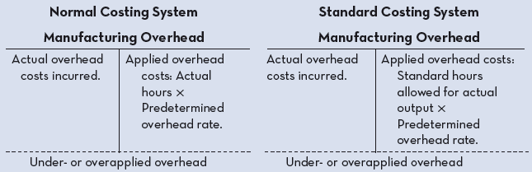

Overhead Application in Standard Costing
Notice the difference in Applied OH
Actual vs. Standard

Slide 12
Overhead Application in Standard Costing
Fixed Manufacturing OH
Actual OH
Dr: Manufacturing OH… Cr: Cash, AP, Supplies…
$140,960
$ 136,800
OH Applied
Each time a unit is produced, we allocate
standard hrs * standard rate
$ 4,160
(3 hrs per unit * $9.5 standard rate * 4,800 units)
Under Applied

Slide 13
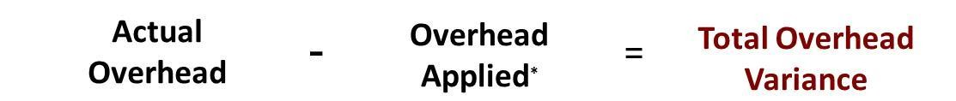
Manufacturing Overhead Variances
Manufacturing Overhead Variances
Total overhead variance is the difference between actual overhead costs and overhead costs applied to work done.
Computation of actual overhead is comprised of a variable and a fixed component.
Formula for the total overhead variance
In a standard cost system:
Unfavourable variances are equivalent to underapplied overhead.
Favourable variances are equivalent to overapplied overhead.
The sum of the overhead variances equals the under- or overapplied overhead cost for a period.
28

Slide 14
Why Use a Standard Cost System?
Pros:
Helpful to identify variances and implement management by exception.
  Management by Exception focuses on identifying and handling cases that deviate from the norm
Can help promote efficiency by setting clear standards for employees.
Can easily integrate responsibility accounting.
Cons:
Variances take time to compute and analyze – risk of information being outdated.
If not used properly (assign blame) – risk of “gameplaying” to cover up variances.
Favorable variances could represent a problem (lower quality of materials…)
Focus on numbers instead and may forget other important objectives.

Slide 15
Any Questions?

